Slide 1
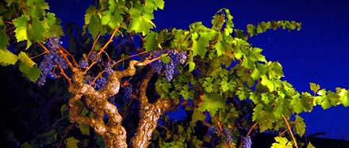
The History of Grape Growing and Wine Making in Lamorinda

Slide 2
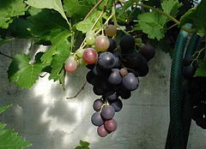
Ah, wine………………
Jesus' first miracle was turning
water into wine, and Christians today
believe that consecrated wine is the "blood
of Christ". The Bible
“Wine can be considered with good reason as the most healthful
and hygienic of all beverages.” – Louis Pasteur
“My only regret in life is that I did not drink more wine.” –
Ernest Hemingway
“Age is just a number. It’s totally irrelevant unless, of course, you happen to be a bottle of wine.” Joan Collins.
“I cook with wine, sometimes I even add it to the food.” W.C. Fields.

Slide 3
The Early California Missionaries
In 1779, Franciscan missionaries under the direction of the Spanish Father Junipero Serra planted California's first sustained vineyard at Mission San Diego de Alcala. He went on to found eight other California missions and became known as the "Father of California Wine".
The varietal he planted, Listan Prieto, was imported by Serra from southern Spain. Years later it was referred to as the “Mission” to distinguish it from other vines being imported.
]

Slide 4
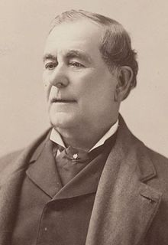
General Mariano Vallejo
1822 Mexico gains its independence from
Spain and takes over the 21 Spanish missions.
1846: Vallejo is the Mexican military commander
of northern California, but seemed to be favorable to an
American California. As commander he had received various
land grants and has hundreds of acres of vines. When Mexico withdraws, he is imprisoned, his land looted.
In 1848, California became American territory after the
Mexican American War, and became the 31st state in 1850.
.
Mariano Vallejo
1807-1890

Slide 5
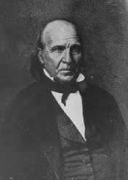
1852 Following a short imprisonment,Vallejo served on the California State Senate, and began to accrue vineyards and property again. He takes over the Sonoma Mission and replants cutting taken from the other mission vineyards.
Sometime later he provides cuttings to
George Yount (Yountville), who had worked
for Vallejo as a carpenter. Vallejo gives Yount
the Rancho Caymus Land Grant. Yount heads
east to Napa to plant them, and to what soon
became the Napa Valley wine industry.
The city of Vallejo is named for the General, Benecia for his wife.
George C. Yount

Slide 6
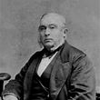
Jean-Louis Vignes
The first “commercial” winery was established
in Los Angeles by an immigrant from Bordeaux,
Jean-Louis Vignes. Most of the European immigrant population lived in southern CA.
Not happy with the quality of the “Mission” grape, he imported vines from France. By 1851 he had 40,000 vines under cultivation and was producing 1,000 US barrels per year.
Major wine production starts to shifts to northern California largely due to the increase in population following the Gold Rush
which also brought an increased demand for wine.

Slide 7
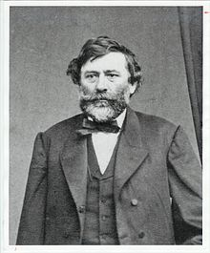
Agoston Haraszthy “the Count”
Around 1857, Hungarian born Haraszthy
Began importing cuttings from prominent
European vineyards to California. He first planted
his “purple gold” in SF and then in San Mateo
County, before moving his operations to an 800
acre site in Sonoma.
Unlike Vallejo and most other growers, and after being impressed by a dry-farmed vineyard on the site, he planted his vines on the slopes without irrigation (as they still do in the Chianti Classico region of Italy). Today, the value of dry
farming to create “superior” wine is still
uncertain.

Slide 8
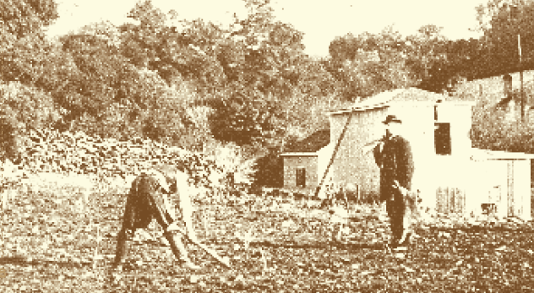
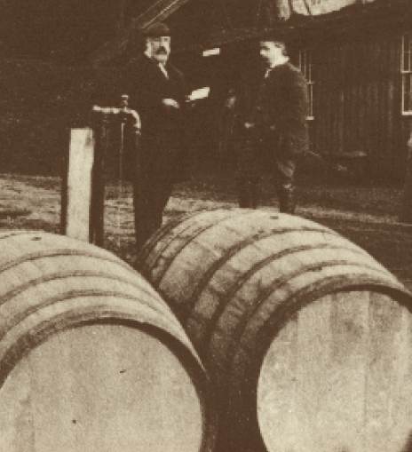
Always trying new ideas, Haraszthy dug extensive caves for
cellaring the wines from his Buena Vista Winery, promoted
hillside planting, and even suggested the use of redwood for
casks when oak supplies ran low.
But claims that he was the original importer of Zinfandel into
the State proved to be false. He did though proclaim himself "The
Count of Buena Vista“.
1869 Haraszthy dies in an alligator-infested river in the jungles
of Nicaragua.

Slide 9
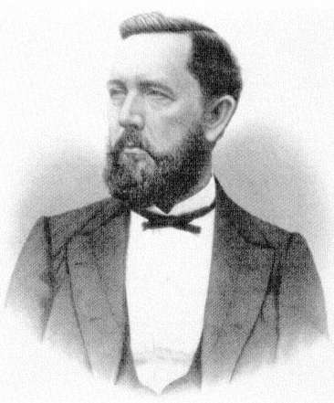
Clayton Vineyards
Charles Rhine (Poland) planted a 30 acre vineyard just south of Clayton. known as Mitchell Canyon Vineyard.
Dominic Murchio (Italy) settled in Clayton in 1878 planted vines and opened a winery. The property is still owned by the Murchio family today.
Charles Kohler (Germany) a distiller, violinist and
bottle maker by trade, planted 80 acres in grapes
around 1878 just southwest of Clayton on Marsh
Creek Road. He also had vineyards in So. CA.
Philip Morshed, a miner by trade, planted vineyards on the adjoining property to Kohler.

Slide 10
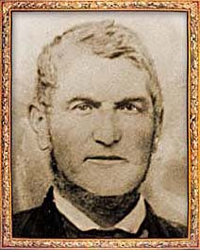
Joel Clayton & the Sherry House
Joel Clayton planted 28 acres with a variety of grapes, near the junction of Mitchell and Mount Diablo Creeks (now North Gate Road). He also built a small winery to distill sherry and brandy. His vineyards thrived in this soil, producing good wines which commanded high prices, so many other settlers followed suit.
The winery’s production ranked 2nd in the county, at 200,000 gallons, surpassed only by Martinelli’s Mt. Diablo Winery
When Joel Clayton died in 1872, his
heirs sold the vineyard and sherry house, which encompassed 43 acres, to Paul De Martini.

Slide 11
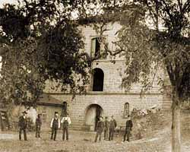
Paul De Martini
De Martini expanded the vineyards and
started building a large stone winery
south of the Sherry House. The winery
Was on Clayton road (across from Mt.
Diablo Elementary School)
With completion of the winery in 1885, he was able to expand wine production from not only his 20 acres, but also 150-200 tons that he purchased from neighboring vineyards.
De Martini made twice-a-week wine wagon runs into east Contra Costa County’s coal mining regions. The De Martini winery produced prize-winning wines, winning first place for port and sherry at the St. Louis Exposition in 1904. The winery’s production ranked second in the county, at 200,000 gallons.
.

Slide 12
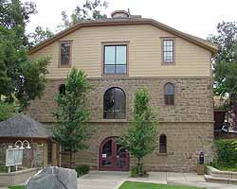
De Martini Winery restored, now the Clayton City Hall & Police Station (2000)

Slide 13
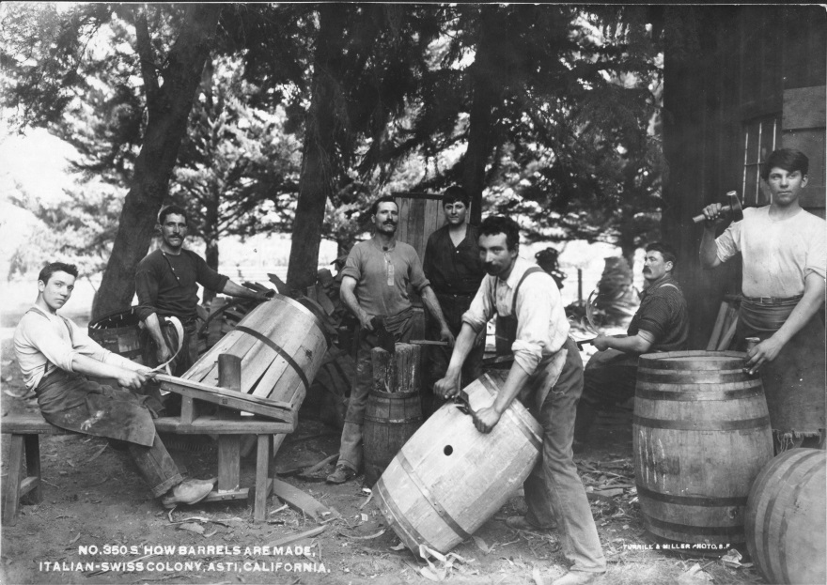
The Mt. Diablo Vineyard Company
After acquiring vineyards in 1882 Jacob Levi, a grocer and wholesaler by trade, along with Otto H. Greenwald organized the
Mt. Diablo Vineyard Co.
Total area: 100 Acres of Mission, Zinfandel, Chasselas and Riesling.
Moses Samuel & sons increased the acreage with property to the north, Galt and Sacramento.
1911: All holdings in CCC were sold
To the Italian Swiss Colony, which
operated until Prohibition, and started
up again in Asti following .

Slide 14
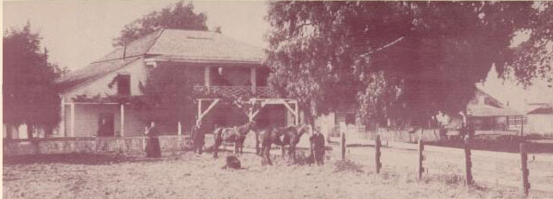
Concord
Salvio Pacheco Adobe, 1850’s
1880’s and 1890’s Concord had many small vineyards, mostly planted in Zinfandel. The rich, level land which surrounded the town of Concord however was better know for walnuts and almonds.
Peter Crenna (Italy) in 1897 built the Concord Winery south of town, just east of Galindo Street and San Miguel Road. He had 60 acres of vines and also made the wine for some of the other growers in the area.

Slide 15
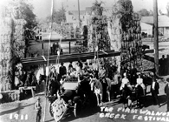
Walnut Creek
The Southern Pacific train and Walnut Creek station, circa 1892, was built on land donated by Antonio Botelho.
The train provided the biggest economic boom for the expanding businesses on Main Street.
1911: The Grape Carnival is held on Main Street to celebrate the grape harvest, and probably more important, the arrival of electrical service.

Slide 16
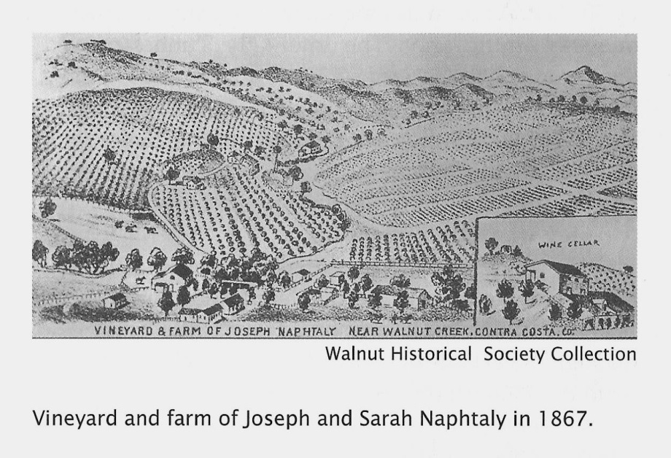
Station Saranap
Joseph Napthaly, a native of Prussia,
sometime between 1874- 1884 gained
title to a large part of the El Sobrante
Grant that included the land above
the winding Tice Valley Road. He had
repeatedly planted grain, but cheaper
product from Oregon convinced him to plant vineyard and orchards.
Napthaly planted Zinfandel, Chasselas, and Riesling grapes on the west side of Walnut Creek in the area that is known as Rossmoor.
The winery, (now Del Valle School) operated until Prohibition. Only rows of olive trees are left to indicate the former vineyard boundaries.

Slide 17
From The Contra Costa News, 1897
Caption: “The Naphtaly Vineyard”
“In 1867 about 150 acres were laid out with choice foreign varieties of grapes. Gently sloping hills with a southern exposure were ideal. According to Manager Pietro Grena, “wine produced here commands the best prices in the market”
Workers excavated many tons of rock to provide cool storage during hot weather. Nearby a distillery produced grape brandy from the vineyards and farm of Joseph Naphtaly.”

Slide 18
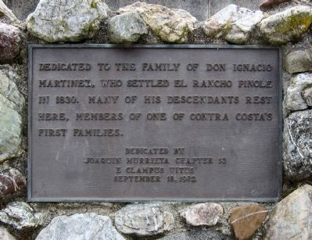
Pinole
Don Ignacio Martinez: Served in Spain's colonial army in Alta California, and was stationed at the San Diego presidio.
In 1836, following his military career he moved his family to Rancho el Pinole, a grant of land, 17,000 acres, in Contra Costa County which had been awarded to him for service (now) to the Mexican government. Thought to be one of the first vineyards in CCC. He produced both table and wine grapes. The property was known as El Pinole.
Martinez died in 1848.

Slide 19
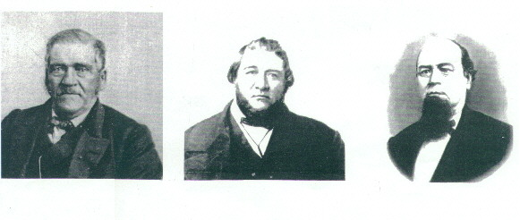
Pacheco
Pacheco Family
John Gambs (Frankfurt, Germany) planted Zinfandel and Chasselas. Operated his vineyard until 1900.
William Hook (Virginia, USA). His property was the west side of Hwy 21 at Hookson Road and the Southern Pacific Station. The property passed to Vincent Hook in 1890. He plants 50 acres of Mission, Malvoisie and Chasselas grapes. The property is now Oak Place Blvd in Pleasant Hill.
Frank Louks, viticulturist, son of a 49er erected a winery in 1889 with an annual output of about 25,000 gallons.
In 1904 the California Wine Association erected a large (wooden) Martinez Winery. Closed at Prohibition.

Slide 20
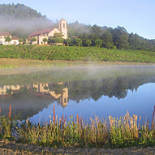
Martinez/Alhambra Valley
1879: This is where the Christian Brothers entered the California Wine Industry. The vineyard, just south of the Martinez courthouse, had grown to 35 acres by 1890.
In 1931 the Christian Brothers Winery moved to the property of Theodore Geir (German-born Oakland liquor dealer), due to the increasing urbanization of Martinez. The property was west of Napa in the
Mayacamas hills and became the Christian
Brothers‘ Mont La Salle Winery, today's
Hess Collection Winery.

Slide 21
Dr. John Strentzel
Father in Law of John Muir, concentrated on growing
imported varieties of vines from Europe, but phylloxera
wiped them out and he turned to a hardier domestic
grape stock. Eventually Strentzel grew the first Muscat
grapes in California as well as Tokays, Catawabas, and Malagas.
Strentzel also invented several planting practices that became standard, such as planting table grapes in the valley floor and wine grapes on the hilly slopes.
By 1880 the variety of grapes grown by Muir & Strentzel included: Isabelle, Tokay, Muscat of Alexandria, Rose Peru, Malaga and Zinfandel.

Slide 22
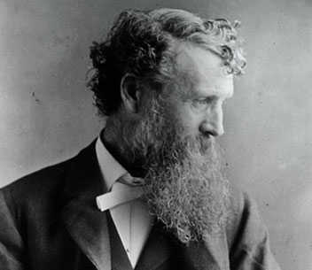
John Muir: Naturalist, Conservationist, Gentleman Farmer.
In 1879 he married the only daughter of Dr. John Strentzel, a wealthy fruit-grower of Contra Costa County. When not out on an exploring trip, he kept busy in the management of the large vineyard and orchard. About 2/3 of his vines were allocated to table grapes.
1882-1888: Considered his “lost years” by his critics as no articles or books were written by him at this time. John was trying to settle into farming and family.
1890: Following Strentzel’s death, John Muir and Louise moved to
the 2nd floor of the 10,000 sf house overlooking the Alhambra Valley.

Slide 23
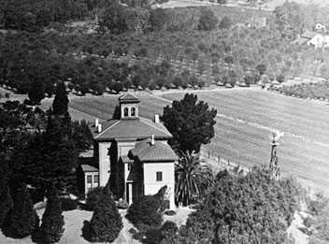
As new vines were planted, Louise
insisted on precise and even rows
“to last 100 years”.
John Muir “For ten years I was engaged in fruit-raising in the Alhambra Valley, near Martinez, clearing land, planting vineyards and orchards, and selling the fruit, until I had more money than I thought I would ever need for my family or for all expenses of travel and study, however far or however long continued. But this farm work never seriously interrupted my studies”
It did however seriously effect his health.

Slide 24
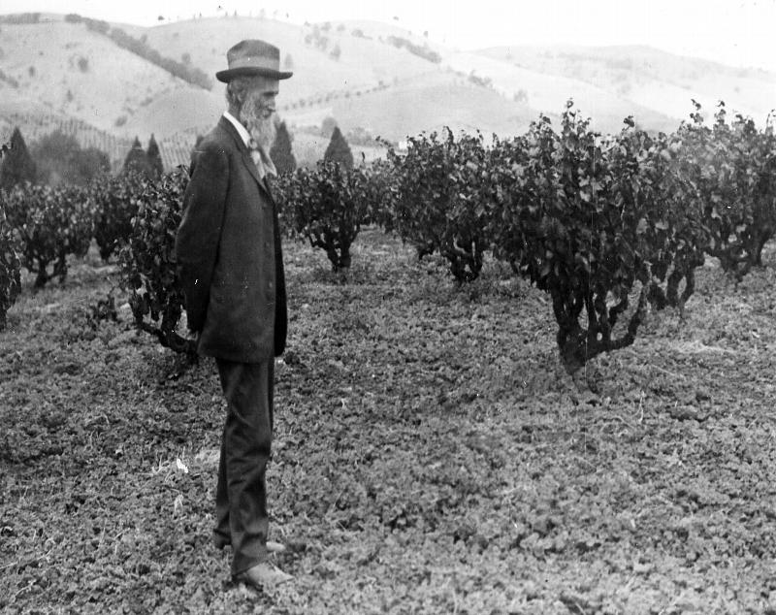

Slide 25
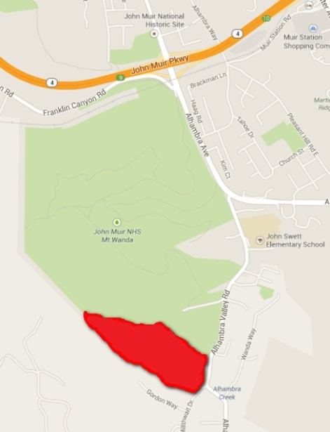
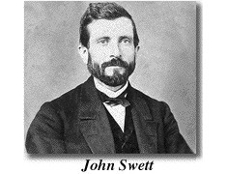
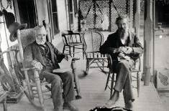
John Swett’s “Hill Girt” in Alhambra
Hill Girt was a 171-acre ranch, “discovered” by John Muir and John Swett. Swett (New Hampshire) a high school teacher in San Francisco, bought the property as a summer home, but it eventually became the family's permanent residence. Along with 70 acres of wine grapes, including Cabernet, the ranch grew many fruit and nut crops. In 1898 he replanted new resistant rootstock following the Phylloxera outbreak.

Slide 26
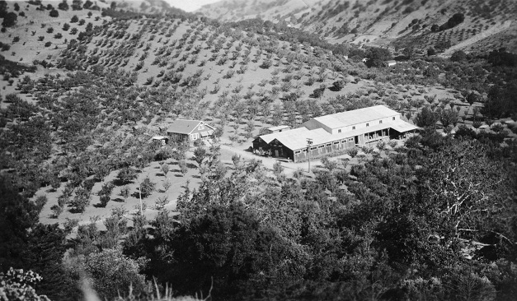
The Upham Family, Alhambra Valley
In 1885 Bradford and Gertrude Upham began 4 years of camping on a friends ranch in Alhambra Valley. After researching the soil, climate and geology of the valley, they purchased 400 acres of the “best land in the Alhambra Valley.” In 1889, with the help of his father-in-law, Bradford began to plant grapes and start up a winery. Fairly small production, but award winning wines.

Slide 27
Other Martinez Wine Growers
1858: R. Barber had 4,000 vines along Alhambra Creek in Alhambra valley.
1863: John Strentzel had 10,000 vines also along the creek, his white wine winning an award at the State Fair. Strentzel’s daughter Louise, marries John Muir.
1886: Judson Colton (Sacramento) plants a 50 acres vineyard, and in 1908 erects a 2 story winery next to the Southern Pacific tracks. His was the largest independent winery in the Country, at 100,000 gallons.

Slide 28
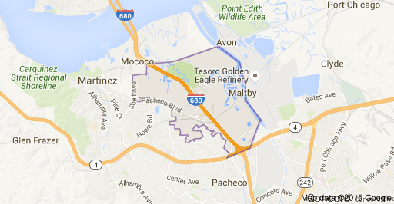
Charles Merrell, physician (Massachusetts, USA). 1880’s. 80 acre vineyard and the Los Lomas Winery on Pacheco Blvd (Vine Hill) of Riesling, Grenache and Chasselas.
Fabian Joost, 1884. 23 acre vineyard and vintage of 20,000 gallons. Operated in Vine Hill Region until Prohibition.

Slide 29
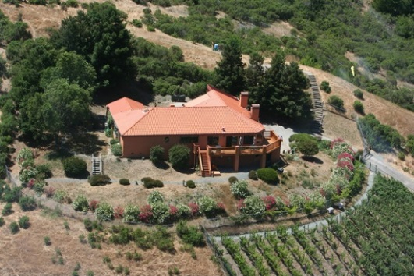
Trelut Ranch/Eagle Hill
The Trelut brothers: Ernest, Frank and Etienne arrived in Moraga in 1880 and promptly took up squatters' rights on the 150 acre parcel at the top of Bollinger Canyon Road. They were most likely the first large-scale winemakers in the area.
Today, the vineyard on the property continues the tradition of winemaking (but in much smaller production) with 446 Cabernet Sauvignon, Sangiovese and Cabernet Franc vines which produce about 900 bottles of wine
a year and is now referred to as “Eagle Hill”.
.

Slide 30
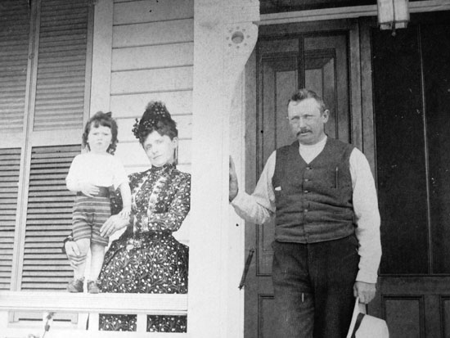
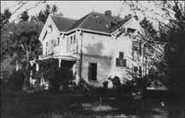
Theodore Wagner/Orinda
By 1897, Theodore Wagner (Wagner Ranch) was commercially growing grapes in the Orinda area. While some grapes were made into wine locally, most were shipped out of the area, with much of the production sold to immigrant Italians in San Francisco's North Beach.

Slide 31
Varietals grown in CCC
In the formative years of the California wine industry, vineyards were initially planted with these varietals:
Mission
Zinfandel
Petite Sirah
Grenache
Riesling
Malbec
Sauvignon Blanc
Sauvignon Vert
Hamburg
Semillion
Flame Tokay
Petit Verdot
Furmint
Pinot Noir
Gamay
Muscadelle
Cabernet Franc
Muscaat
Carmenere
Cabernet Sauvignon

Slide 32
Why there were where they were:
The driving issue for succesful vineyard location in Contra Costa County was transportation. Without refrigeration the grapes could not be moved long distances and “over road” transportation was expensive.
The ports of Antioch and Martinez were within practical range for the vineyards of Walnut Creek to Martinez. But the hills of Lafayette, Orinda and Moraga were quite a distance from the Contra Costa commerce hubs on one side, and blocked by the steep Oakland/Berkeley hills on the other.
Transportation was too costly to prove advantageous for the many grape growers. Most of these vineyards were used for family and local consumption.

Slide 33
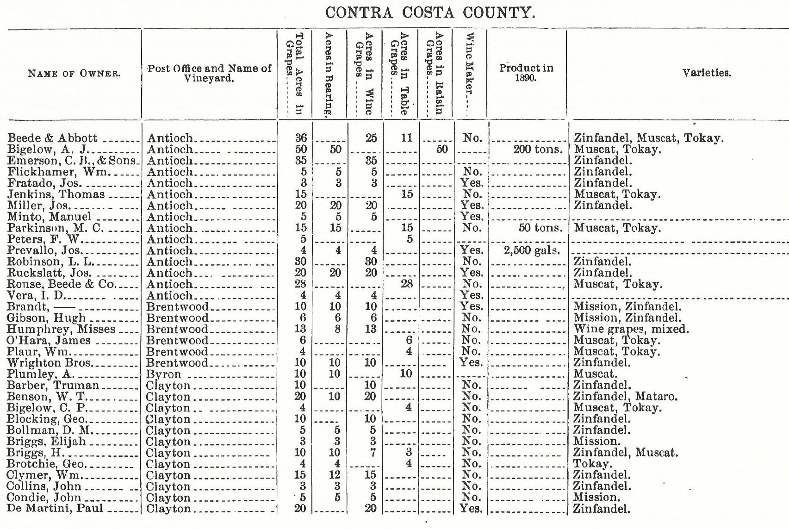
1891 CA Grape Growers Directory CCC

Slide 34
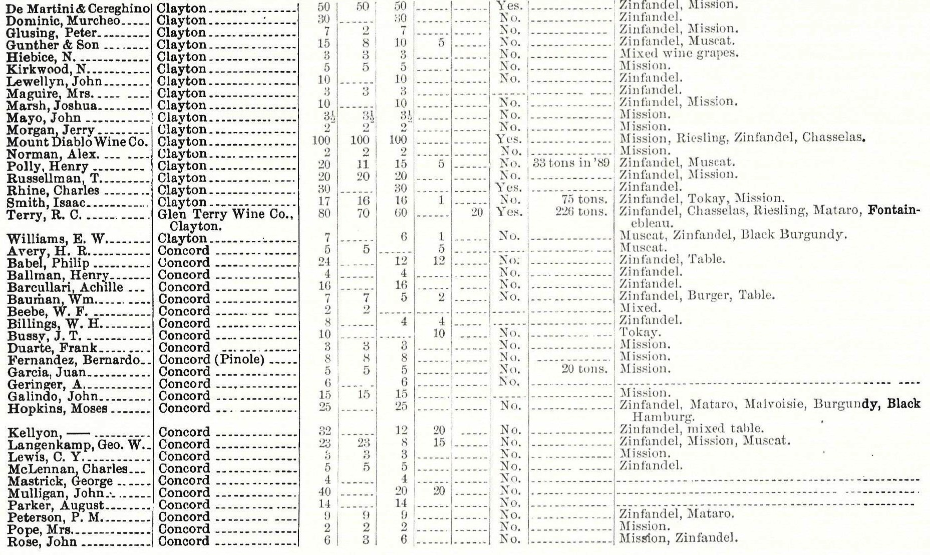

Slide 35
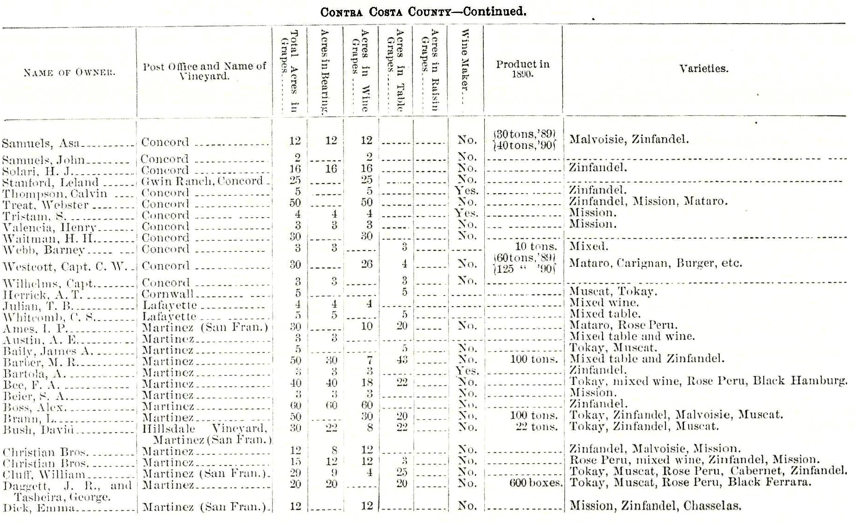

Slide 36
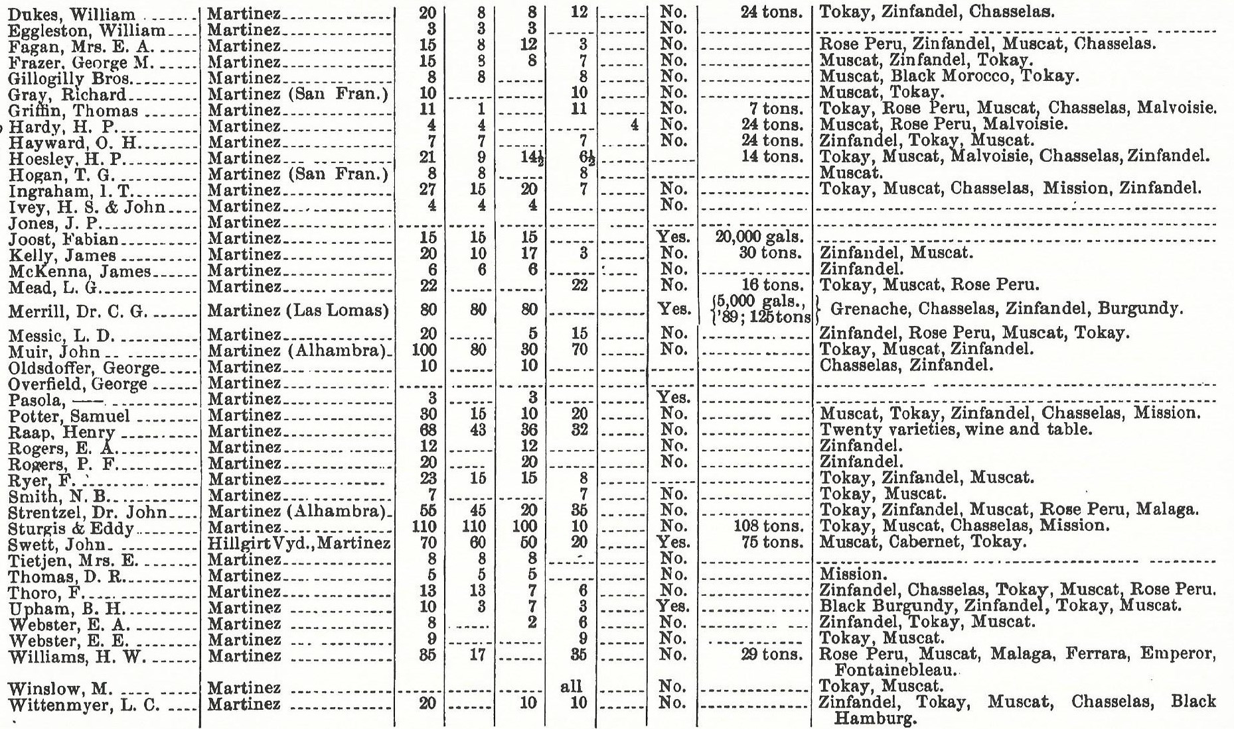

Slide 37
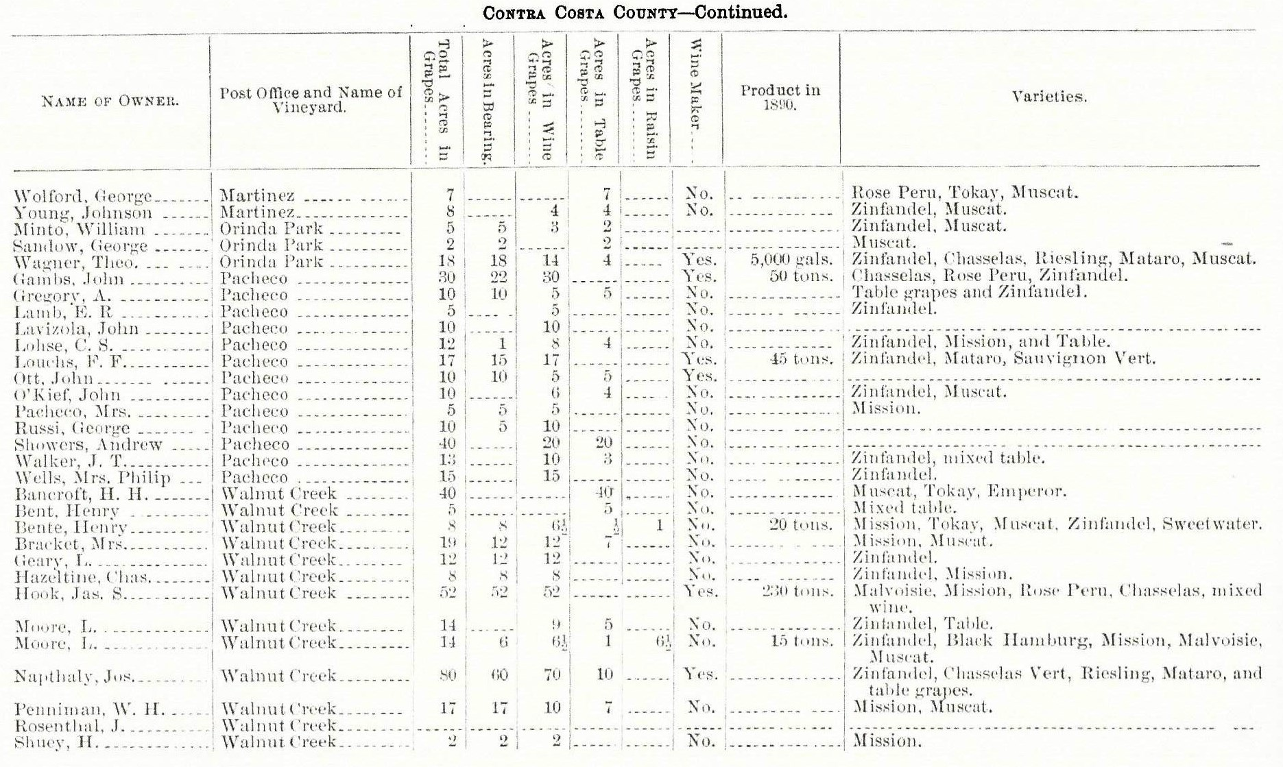

Slide 38
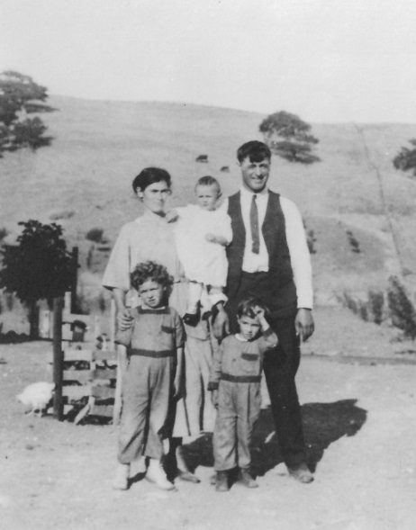
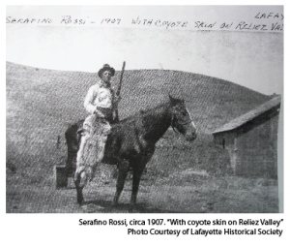
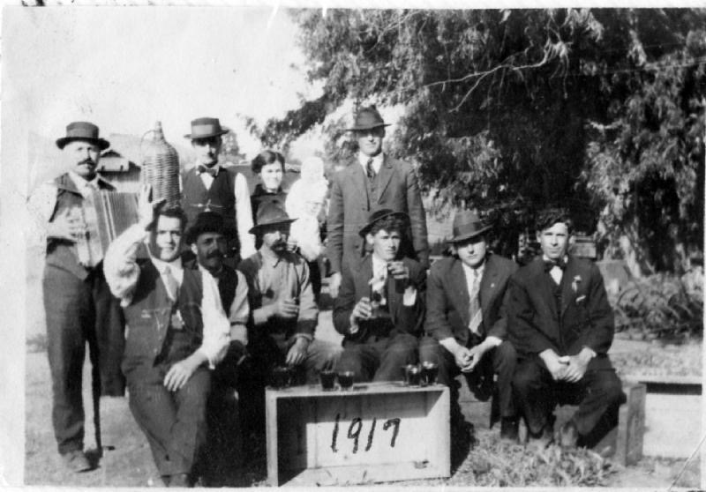
Rossi Family, Reliez Valley
1907: Serafino Rossi grew wine grapes, and other produce, at a site now occupied by Reliez Valley Vineyards in Lafayette.
The family sold their produce in Oakland, but that took a 4 or 5 hour journey up Fish Ranch Road or through the very narrow, recently opened tunnel.

Slide 39
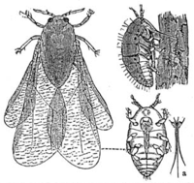
So What Happened?
1880: The first disaster for the CA wine industry was Phylloxera, a microbe that feeds on and destroys the vines' roots. The infestation struck the Valley about the same time it was ruining French vineyards. All growers who could afford to replanted their vineyards by grafting Muscat, Tokay and other European stocks onto native American Phylloxera-resistant vines. No one realized until this point that European vines, not American vines, were the ones susceptible to this microbe.

Slide 40
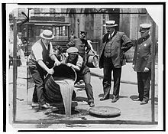
1920: The second disaster for the wine industry was the Prohibition Act which forced most wineries to close. 33 States had gone “dry” by the start of World War 1.
Otherwise law abiding citizens soon became bootleggers and home wine makers.
But most growers replaced quality wine varietals with table variety grapes which transported well, but gave California an abundance of poor wine grapes until 1971.

Slide 41
After Effects
Before 1920, there were more than 2,500 commercial wineries in the United States. Less than 100 survived as winemaking operations to 1933. By 1960, that number had grown to only 271. California had 713 bonded wineries before Prohibition; it took more than half a century, until 1986, before that many were again operating.
After Prohibition ended, wine production grew steadily, from 200,000 gallons a year in 1937 to more than 40 million gallons in 1986.

Slide 42
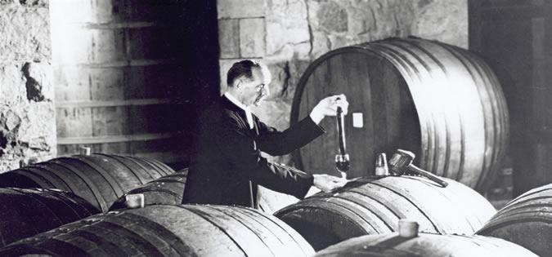
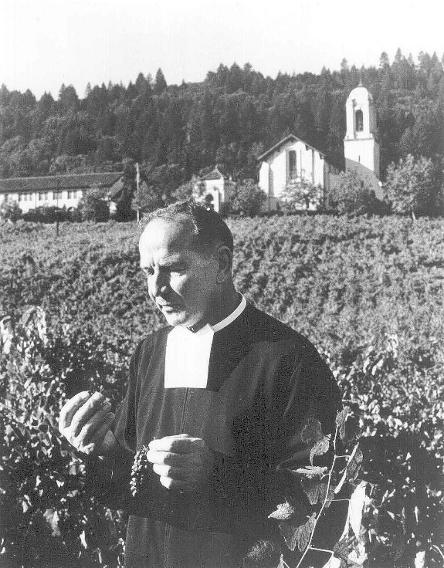
Following Prohibition
Following Prohibition, Brother Timothy Diener, became the winemaker for Christian Brothers, making sacramental wine. He attended St. Mary's College in Moraga but before finishing his education, he got sidetracked by a winemaking assignment that then became a career that lasted for more than half a century.
Many famous Napa/Sonoma wineries began as a result of his ideas.
One rumor states that Hacienda de las Flores in Moraga was, for many years, the headquarters of Christian Brothers.

Slide 43
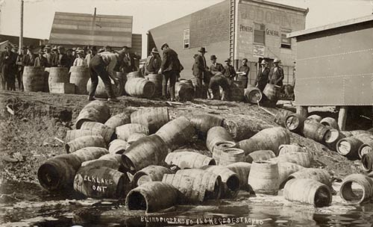
Prohibition led to the closure of 95 percent of all wineries in the United States, including most Contra Costa wineries. Some wine grape growers survived by putting their fruit on trains to Canada and the East Coast to be used for home winemaking, which remained legal and became one of America's favorite pastimes.
Christian Brothers continued to make sacramental wines through Prohibition, producing more than 80,000 barrels in 1925, but their winery in Martinez burned in 1937.
After Prohibition was repealed, wineries began to open again in Contra Costa County, including: Digardi Winery, Viano Vineyards and the J. Gonsalves Winery. Viano Vineyards has been making wine at their family winery ever since.

Slide 44
13 Historic, Still Operating Vineyards
Big Break: 1910 – now Cline
Bridgehead: 1900 – now Cline
Carla’s: 1900 – now Rosenblum
Del Barba: ? – now Neyers
Duarte: 1890 – now Rosenblum & Turley
Evangehlo: 1910 – now Cline, Neyers, Turley
Live Oak: 1890 – now Cline
Mori: 1930 – now Turley
Pato: 1940 – now Phinney & Neyers
Planchon: 1900 – now Franus & Rosenblum
Salvador: 1890 – now Turley
Small Berry: 1910 – now Cline
Spinelli: ? - Now Three Wine Co. & Trinitas

Slide 45
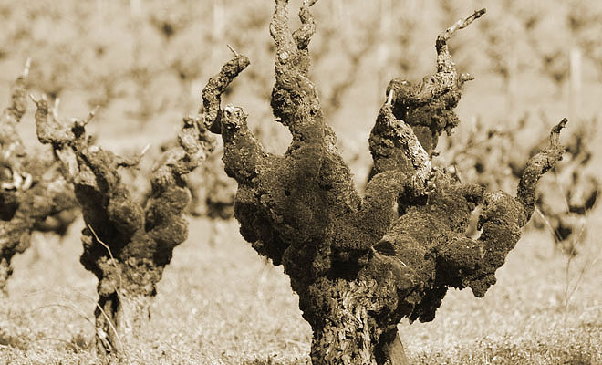
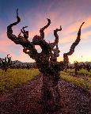
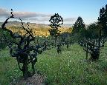
Cline Cellars has a 100-year old-vineyard of Mourvedre near Oakley that represents much of California's supply of this varietal that was once widely grown in Contra Costa.

Slide 46
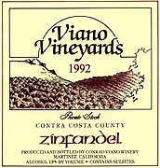
Alhambra Valley Today

Slide 47
Current California AVA’s

Slide 48
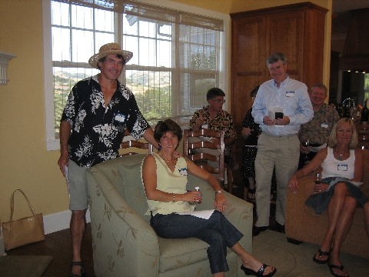
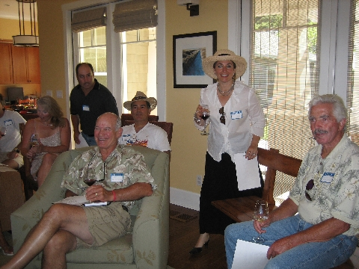
First LWGA General Meeting 2005
Conceived by Joao Magalhaes & David Parker

Slide 49
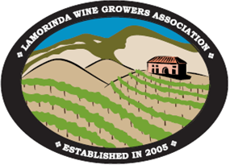
LWGA
The specific purpose of the Lamorinda Winegrowers Association is
to provide on-going education and support for its members in the areas of vineyard maintenance, management and winemaking;
Also to: Foster communication and the exchange of information among its members;
Encourage sustainable practices, resulting in the production of high quality grapes and wine in an environmentally-friendly and socially responsible fashion;
Promote the Lamorinda community and its status as a winegrowing region, enhancing the marketability of Lamorinda-grown grapes and Lamorinda-made wine; and cultivate a strong relationship with the local community.

Slide 50
LWGA Founding Benefactors/Members

Slide 52
What & Why?
An American Viticultural Area is a designated wine grape-growing region in the United States distinguishable by geographic features, with boundaries defined by the Alcohol and Tobacco Tax and Trade Bureau (TTB), United States Department of the Treasury.
AVA’s range in size from the Upper Mississippi Valley AVA at 29,900 square miles across four states, to the Cole Ranch AVA in Mendocino County, CA, at only 62 acres. The Augusta AVA near the town of Augusta, Missouri, was the first recognized AVA, in 1980.
Unlike most European wine appellations of origin, an AVA specifies only a geographical location from which at least 85% of the grapes used to make a wine must have been grown.

Slide 53
Benefits of an AVA
The first benefit is to the grape grower. An AVA defines the characteristics of an area. The grower within the AVA will have more of a story to tell. The AVA allows the grower to define his or her story and tie it to his property.
The second benefit is for the winery that uses grapes from the AVA. With the winery, the message or story is increased and the winery can use it to distinguish itself from other wineries.
The consumer gets the third benefit: people like to know where the wine comes from not only from a safety and sustainability aspect, but also about the unique characteristics that define the grapes grown in a particular AVA.”
Finally, wine and grapes are about location, they speak of the soil from which they grew.

Slide 54
Lamorinda Appellation (AVA)

Slide 55
The Petition for “Lamorinda”
A petition was prepared and filed with the TTB
to establish a New AVA to be named "Lamorinda”.
“Viticulture” is the science, production and study
of grapes.
The area described (Lamorinda) includes nearly 139 acres (at application date) of planted vines and planned plantings.
The following Unique Characteristics of the area were cited:
All viticulture limited to moderate – to – moderately steep slopes carved from uplifted sedimentary rock.
Despite its position near intrusions of coastal air, Lamorinda is protected from much of the coastal cooling influences.

Slide 56
Our geological rock is younger, less resistant (to weathering) sedimentary rock, than neighboring rock. Other surrounding areas are of “active deposition”.
Soils in Lamorinda have higher clay content, a result of weathered claystone. The topography allows for shallow soils and good runoff.
Daytime microclimates are more dependent on slope, orientation, and exposure, leading to a large number of microclimates.
Suburban landscape with low density housing leading to a large number of small vineyards.
All vineyards require the use of hand pruning and harvesting.

Slide 57
Moraga Vineyards Today:
VILLA CALACOLA
Planted 2004: Pinot Noir Syrah & Merlot
CAPTAIN VINEYARDS
Planted: 2005: Petit Verdot,
Pinot Noir, Cabernet, Petit Sirah
PARKMON VINEYARDS
Planted: 2004: Viognier, Pinot
Noir, Sangiovese, Zinfadel, Syrah, Petite Sirah, Cabernet

Slide 58
RHEEM VALLEY
Planted: 2007
Cabernet Savignon
QUAIL HILL
Planted: 2005
Pinot, Merlot & Syrah.

Slide 59
BULLFROG CREEK WINERY
Planted: 2011 – Viognier, Sauvignon Blanc,
Pinot Noir.
MILLER FAMILY
VINEYARD
Planted 2007: Sangiovese
VINCENZA RANCH
Planted 2006: Petite Sirah

Slide 60
PETIT JARDIN
Planted: 2010
Cabernet Sauvignon
BIRCHWOOD PLACE
Planted: 2000
Sangiovese, Merlot.
Chardonnay.

Slide 61
Lafayette Vineyards Today
RELIEZ VALLEY VINEYARD
Planted 2006:
Cabernet Sauvignon
.
DEER HILL
VINEYARD
Planted: 1998
Cabernet

Slide 62
LOS ARABIS VINEYARDS
Planted 1999:
Pinot Noir
THAL VINEYARDS
Planted: 2011
Cabernet, Sauvignon Blanc &
Merlot.

Slide 63
HAAS VINEYARD
Planted 2007: Chardonnay, Cabernet
COULOIR VINEYARDS
Planted 2011 - Cabernet

Slide 64
ANCIENT LAKES
Planted: 2011
Cabernet, Syrah,
Pinot Noir
TARABROOK VINEYARDS
Planted: 2012
Tempranillo

Slide 65
Orinda Vineyards Today
DAVIDSON VINEYARDS
Planted 2010: Merlot &
Cabernet
Isabelle's Vineyard This, our flagship vineyard, produces
Cabernet Sauvignon, Cabernet Franc and Sangiovese just
outside Moraga
Mary Leigh's Vineyard produces Chardonnay, Sangiovese and Syrah. Located in Moraga.
Mimi's Vineyard located on a slope in the Sleepy Hollow
section of Orinda. This cool vineyard produces Syrah with
great color and character

Slide 66
SCREECHING OWL VINEYARDS
Planted 2007 - Syrah
CHERRY VINEYARD
Planted: 2011
Pinot Noir
LAST ONE PICKED
Planted 2005:
Syrah & Mourvedre
100 Syrah, 50 Mourvedre, 50 Grenache

Slide 67
PINNEY VINEYARD:
Planted: 2010 – Cabernet & Syrah

Slide 68
Much Thanks for the help:
Lafayette Historical Society: Judie Peterson
Dr. James Jim Lapsey, Adjunct Associate Professor in the Department of Viticulture and Enology, UC Davis
John Muir National Historic Site, Keith Parks.
“A History of the Napa Viticultural District” by E. Peninou
“Saranap, Then & Now” by Dorothy M. Lidga
Walnut Creek Historical Society Photos
Ruth Bailey, Lafayette Today
“The Upham Family of Alhambra Valley” by Rich Sandvick
Clayton Historical Society

Slide 69
“Whichever glass you chose, may it be more full than empty.” – Anonymous

